Slide 1
Introduction to Academic & business Writing
Session 01 - English for Communication Skills

Slide 2
Academic writing

Slide 3
Academic Writing Quiz (Academic Writing for International students of Business, Stephen Bailey)
The main difference between academic writing and normal writing is that academic writing:
Uses longer words
Tries to be precise and unbiased
Is harder to understand
2. The difference between a project and an essay is :
Essays are longer
Projects are longer
Students choose projects’ topics

Slide 4
3. Teachers complain most about students:
Not answering the question given
Not writing enough
Not referencing properly
4. The best time to write an introduction is often :
First
Last
After writing the main body
5. Plagiarism is
A dangerous disease
An academic offence
An academic website

Slide 5
6. Making careful notes is essential for:
Writing essays
Revising for exams
All academic work
7. An in-text citation looks like:
(Manton,2008)
(Richard Manton, 2008)
(Manton, R. 2008)
8. Paraphrasing a text means:
Making it shorter
Changing a lot of the vocabulary
Adding more detail

Slide 6
9. Paragraphs always contain:
Six or more sentences
An example
A topic sentence
10. The purpose of an introduction is:
To give your aims and methods
To excite the reader
To summarise your ideas
11. Proofreading means:
Getting a friend to check your work
Checking for minor errors
rewriting

Slide 7
12. Teachers expect students to adopt a critical approach to their sources:
Sometimes
Only for a Master’s work
always

Slide 8
What is academic writing?
Academic Writing is writing intended for a particular audience with a specific purpose in mind. It follows a certain structure and adopts a certain style of writing.

Slide 9
Features of Academic Writing
Shows knowledge and understanding of the subject
Includes original writing
Follows an accepted format and structure of documents
Uses external sources and acknowledges them using a standard scholarly method
Shows evidence of critical analysis and discussion

Slide 10
Academic Writing Requires …
An argument – a specific point of view expressed in the piece of writing
A thesis statement – a sentence (or two) that summarizes the argument. This is usually placed at the introduction of the piece of writing
A line of reasoning – evidence and reasons for the writer’s conclusions / points of view that are logically presented.

Slide 11
Academic Writing Requires …
Critical Analysis – evaluating both the plus and the minus of an argument in order to draw conclusions / questioning ideas for better understanding
Formal Style of Writing– impersonal tone, words to generate precise meanings, formal use of language
A well structured writing process– developing the piece of writing in a methodical process.

Slide 12
Academic Writing Process
Understanding the task (purpose, audience, format)
Planning the task (timing, structure/outline)
Researching (reading , note taking)
Composing (preparing the first draft)
Reviewing / editing and proofreading

Slide 13
Using appropriate language
Levels of formality: Writing in a style that your audience expects and that fits your purpose is key to successful writing.
In-Group jargon: Jargon refers to specialized language used by groups of like-minded individuals. Only use in-group jargon when you are writing for members of that group. You should never use jargon for a general audience without first explaining it.
Slang and idiomatic expressions: Avoid using slang or idiomatic expressions in general academic writing.
Biased language: Avoid using biased language including language with a racial, ethnic, group, or gender bias or language that is stereotypical.

Slide 14
Using appropriate language (Contd.)
Avoid contractions (There’s)
Use conjunctions (moreover, however)
Avoid personalizing (We should consider how to apply)
Use nominalization and passive voice as appropriate
Use more precise and concise vocabulary (talk about – focus / think – assume)
Avoid rhetorical questions (How can this be / why does this happen – one possible reason why this happens is …)

Slide 15
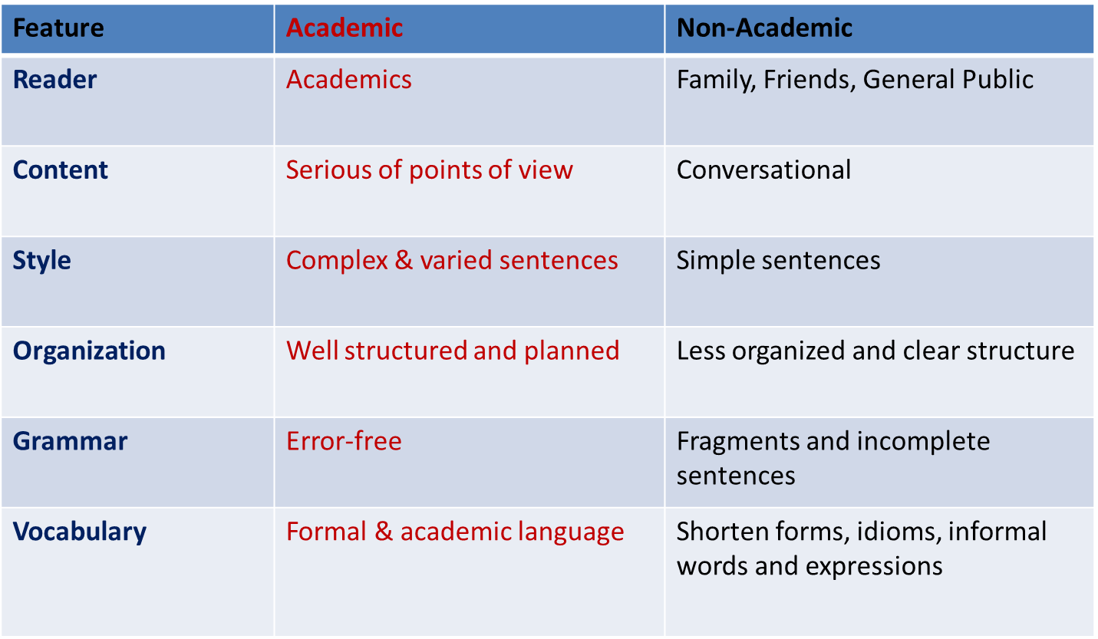
Academic and Non-Academic Writing

Slide 16
Informal (Incorrect):
Hi! I read in the paper that ya'll were looking for a receptionist. I think that I am good for that job because I've done stuff like it in the past, am good with words, and am incredibly well organized.

Slide 17
Semi-formal (Written to a well-known individual):
I am applying for the receptionist position that is currently open in the company. As you are aware, I have worked as a temporary employee with your company in this position before. As such, I not only have experience and knowledge of this position, but also already understand the company's needs and requirements for this job.

Slide 18
Formal (Written to an unknown audience):
I am applying for the receptionist position advertised in the local paper. I am an excellent candidate for the job because of my significant secretarial experience, good language skills, and sense of organization.

Slide 19
Use or avoid jargons ?
If you are writing for a general audience (even a general academic audience) you should avoid using in-group jargon without explanations.
If, however, you are writing to an in-group audience you will want to use group-specific jargon. Not using the jargon when it is expected by your audience can signal to the audience that you are not a member of that group or have not mastered the group's terminology.

Slide 20
Avoid Slang and Idiomatic Expressions
Words like y'all, yinz, cool
Idiomatic expressions like "pull someone's leg," "spill the beans," and "something smells fishy“
These words make your writing sound informal, and hence, less credible.
For non-native speakers of English, these expressions may prove more difficult to understand because of their non-literal nature.

Slide 21
Avoid Complex or Confusing Language
Ex:
“The acquisition of pollution permits by individuals and corporations that produce toxins has now been allowed by the recently amended Clean Air Act of 1990. Institution of permits simplifies and clarifies obligations for business and industry, making environmental protections more accessible for these constituents. The government and the Environmental Protection Agency will be greatly assisted in their endeavors by monitoring the release of all substances and having the substances listed on one individual permit.”

Slide 22
Avoid Stereotyped Language
Incorrect: Although she was blonde, Mary was still intelligent.
Revised: Mary was intelligent.

Slide 23
Avoid Gender-biased Language
Original: mankind
Alternatives: humanity, people, human beings
Original: man's achievements
Alternative: human achievements
Original: man-made
Alternatives: synthetic, manufactured, machine-made
Original: the common man
Alternatives: the average person, ordinary people
Original: man the stockroom
Alternative: staff the stockroom
Original: nine man-hours
Alternative: nine staff-hours

Slide 24
Avoid Gender-biased Language
Original: steward and stewardess
Alternative: flight attendant
Original: policeman and policewoman
Alternative: police officer
Original: congressman
Alternative: congressional representative
Original: male nurse
Alternative: nurse
Original: woman doctor
Alternative: doctor

Slide 25
Avoid Gender-biased Language
Original: chairman
Alternatives: coordinator (of a committee or department), moderator (of a meeting), presiding officer, head, chair
Original: businessman
Alternatives: business executive, business person
Original: fireman
Alternative: firefighter
Original: mailman
Alternative: mail carrier

Slide 26
Use Appropriate Pronouns
Recast into the plural
Original: Give each student his paper as soon as he is finished.
Alternative: Give students their papers as soon as they are finished.
Reword to eliminate gender problems.
Original: The average student is worried about his grade.
Alternative: The average student is worried about grades.

Slide 27
Use Appropriate Pronouns
Replace the masculine pronoun with ONE, YOU, or (sparingly) HE OR SHE, as appropriate.
Original: If the student was satisfied with his performance on the pretest, he took the post-test.
Alternative: A student who was satisfied with her or his performance on the pretest took the post-test.
Alternate male and female examples and expressions. (Be careful not to confuse the reader.)
Original: Let each student participate. Has he had a chance to talk? Could he feel left out?
Alternative: Let each student participate. Has she had a chance to talk? Could he feel left out?

Slide 28
Business writing

Slide 29
What is business writing?
Business writing is a type of writing that is used in a professional setting. It is a purposeful piece of writing that conveys relevant information to the reader in a clear, concise, and effective manner.
Simplicity, clarity, conciseness and directness are universal principles of business writing. Despite the widespread use of technology in the modern communication methods, writing is still considered an essential skill for effective business communication.

Slide 30
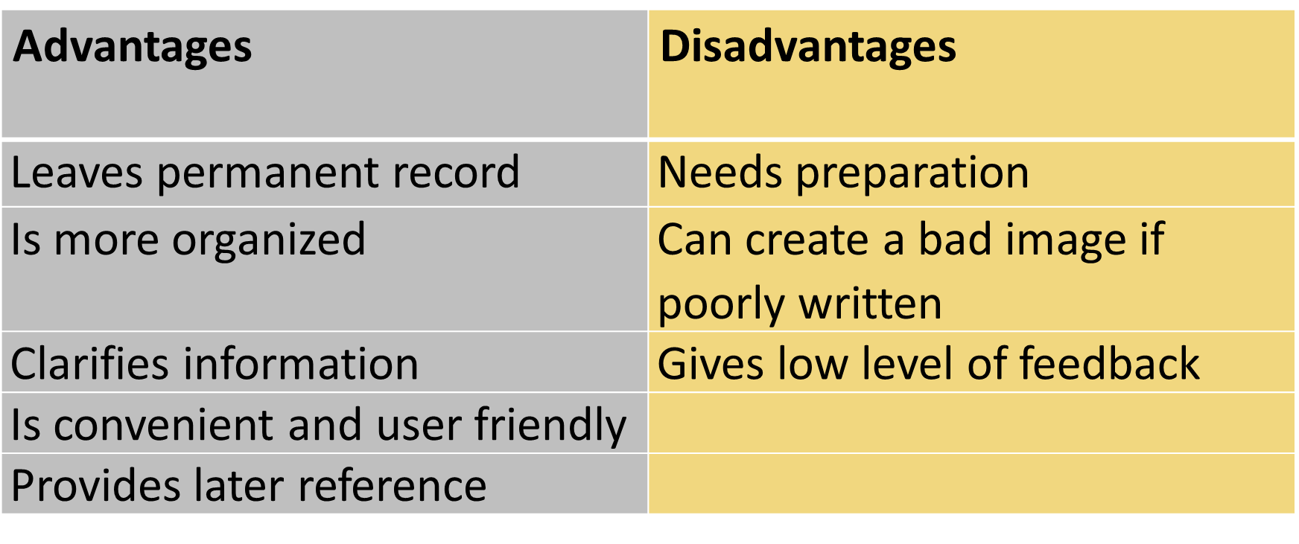
Advantages and Disadvantages of Writing for business

Slide 31
Use of Language in Business Writing
Use words that will clarify the meaning instead of vague terms
Use technical words with caution
Use acronyms appropriately
Use concrete instead of abstract language (active vs. passive, etc.)
Use a polite tone
Use positive language
Use action verbs instead of nouns
Use correct phrasal verbs
Use non-discriminatory language
Use short, but coherent sentences
Use accurate punctuation

Slide 32
Effective Business Writing
Adapt the message to the requirements of the audience.
- who are they (single, multiple, primary, secondary,
culture, preferences)
- what do they know (background, length, format,
background knowledge)
- what do they feel (emotional status, bias, nature of
the expected action)

Slide 33
Effective Business Writing (Contd)
Be straightforward and clear in expression
Use the appropriate tone to maintain goodwill (words)
Write structured paragraphs
Improve the layout and formatting of the document
Use a reader-centred approach
Emphasize important information through structure and formatting
Develop the message gradually (5 strategies of business writing)

Slide 34
Strategies for Effective Business Writing
Prewriting
Drafting
Revising
Formatting
Proofreading

Slide 35
Strategies for Effective Business Writing (in detail)
Prewriting - consider the purpose and context
know the reader
collect information
organize information
prepare the outline
Drafting - focus on main points in the first draft
be concise and straightforward
use the right words
avoid redundancy
avoid fillers

Slide 36
Strategies for Effective Business Writing (in detail)
Revising - be your own critic
consider words/ structure/detail, etc.
look for alternatives
seek feedback
Formatting - do not overdo lay out
improve margins/spaces/ font style
Proofreading - check grammar and spelling
use a hard copy
keep text spacious
check spelling
consider individual sentences

Slide 37
Class Discussion
Discuss in brief the differences between academic & business writing

Slide 38
QUESTIONS?

